Slide 1

ExoPredict
Mandeep
Patrick
Iarsolav
Amrit

Slide 2
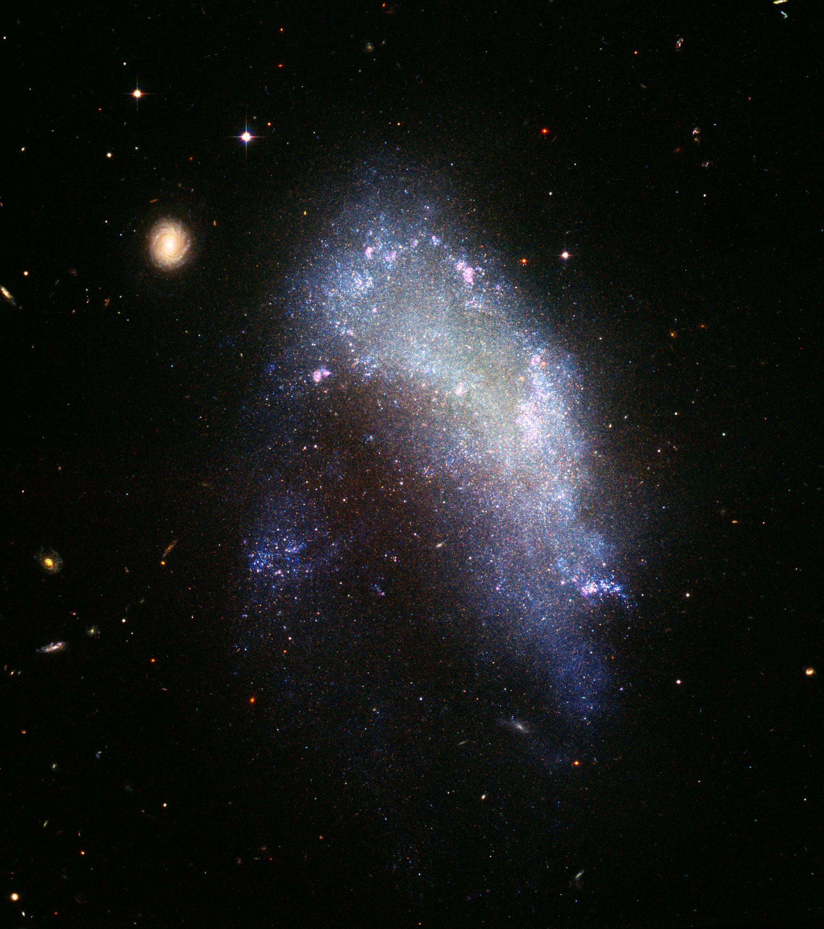


ExoPredict
Classifying and Predicting
Exoplanet Characteristics
Mandeep
Amrit
Iarsolav
Patrick
This Photo by Unknown Author is licensed under CC BY-SA

Slide 3


What are Exoplanets
HOME
This Photo by Unknown Author is licensed under CC BY-SA

Slide 4
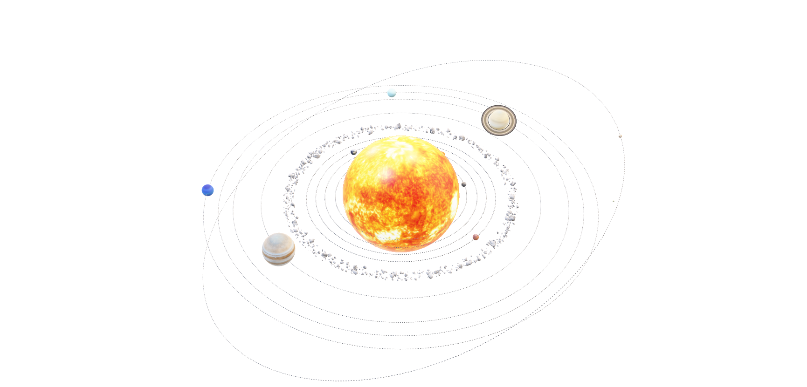
What are Exoplanets
Milky Way
This Photo by Unknown Author is licensed under CC BY-SA

Slide 5
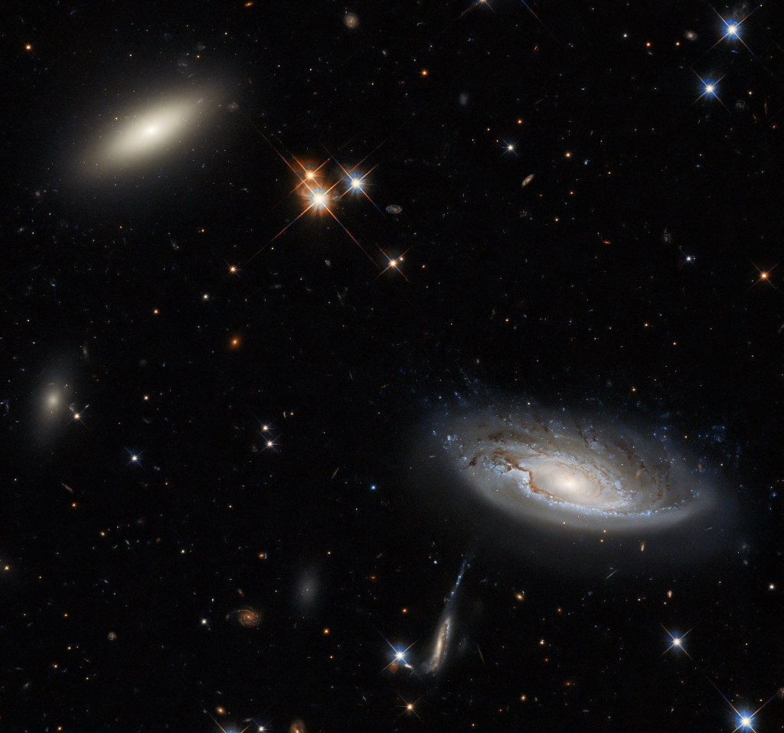
Introduction
Australia is going to have a privilege to host the 76th International Astronautical Congress conference, scheduled to be held in Sydney in 2025, inspiring catalyst for exploration in space science and technology.
By utilizing advanced analytics that we learned throughout our course, we aim to contribute a data-driven perspective to the exciting developments surrounding this prestigious event.

Slide 6

Overview
In this presentation, we delve into a comprehensive dataset connected to the conference, leveraging data analytics to uncover valuable insights such as :
Planet’s habitability
Star’s orbital Impact on stellar temperature
Classification of planets (mass, coordinates)
Similar exoplanets in terms of…
Which facility discovered most exoplanets
What methods are more acceptable than others to discover the exoplanets and why?

Slide 7
Introduction
Resources: NASA EXOPLANET ARCHIVE
https://exoplanetarchive.ipac.caltech.edu/cgi-bin/TblView/nph-tblView?app=ExoTbls&config=PS&constraint=default_flag%3E0&constraint=disc_method%20like%20%27tran%27
ETL process and Data Analysis with PySpark

Slide 8

ETL Process
Extract: Load exoplanet data from a CSV file.
Transform: Clean and preprocess the data.
Load: Save the processed dataset for further analysis.

Slide 9

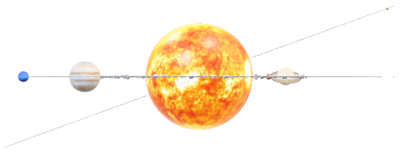
Data Analysis
Successfully implemented an ETL Pipeline for Exoplanet Data

Slide 10
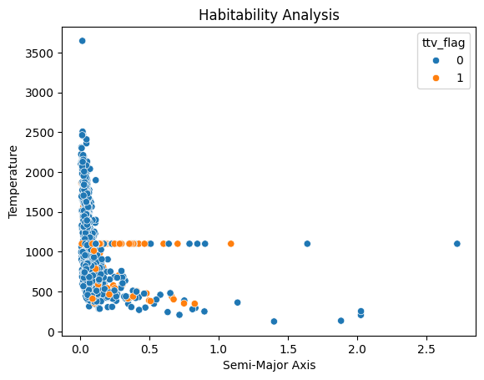
How do planetary characteristics influence the likelihood of being in the habitable zone? (Mandeep)

Slide 11
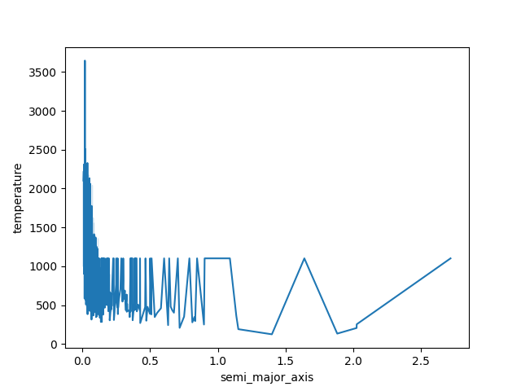

2. How does a planet’s orbit impact its temperature and potential habitability?(Mandeep)

Slide 12

Q1 & Q2: Classify planets by insolation, temperature, mass, coordinates with regards of available planets (Iarsolav) (Iarsolav)

Slide 13

Q1 & Q2: Classify planets by insolation, temperature, mass, coordinates with regards of available planets (Iarsolav) Complete dataset, it'll be helpful to draw graphics with stars located across sphere (Iarsolav)

Slide 14
Question 1: Can we identify groups of similar exoplanets? Analysis: Apply clustering algorithms (e.g., K-means, hierarchical clustering) to group planets with similar characteristics. Question 2: Can we classify planets into different categories (e.g., rocky planets, gas giants) based on their properties? Analysis: Use supervised learning algorithms to classify planets based on features such as mass, radius, and temperature.

Slide 15
Question 1: Can we identify groups of similar exoplanets? Analysis: Apply clustering algorithms (e.g., K-means, hierarchical clustering) to group planets with similar characteristics. Question 2: Can we classify planets into different categories (e.g., rocky planets, gas giants) based on their properties? Analysis: Use supervised learning algorithms to classify planets based on features such as mass, radius, and temperature.

Slide 16

What are the most and least popular discovery methods and why?
Total discovery methods:
Mostly used - Transit
Rarely used - Transit Timing Variations

Slide 17
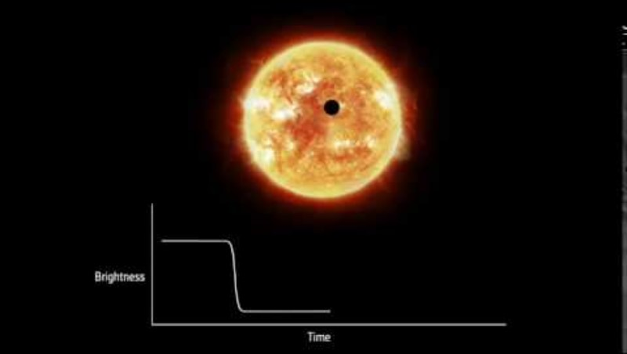

What are the most and least popular discovery methods and why?
Transit-
1102 discoveries
Measure the dimming of a star's light as a planet passes in front of it.

Slide 18
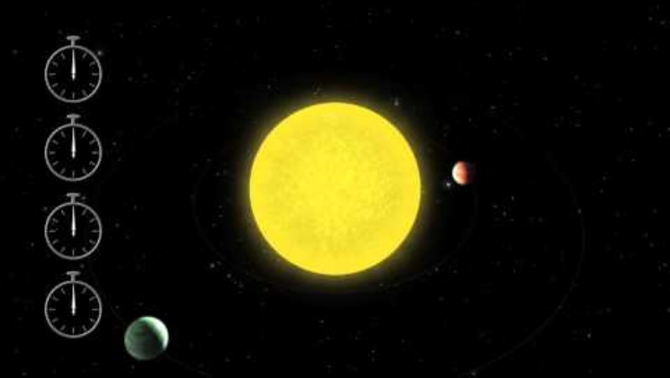

What are the most and least popular discovery methods and why?
Transit Timing Variations –
(TTVs) are changes in the timing of an exoplanet's transit across its star

Slide 19
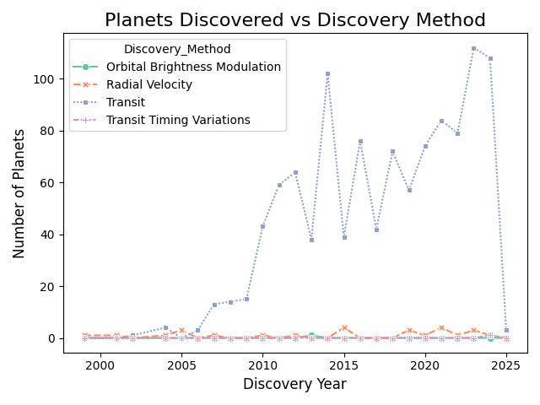
What are the most and least popular discovery methods and why?

Slide 20
The effects of distance variation of a planet host from its exoplanets on its' temperature and luminosity?
Hypothesis
The Exoplanets luminosity and temperature is perpetually inverse to its relative stellar distance.

Slide 21
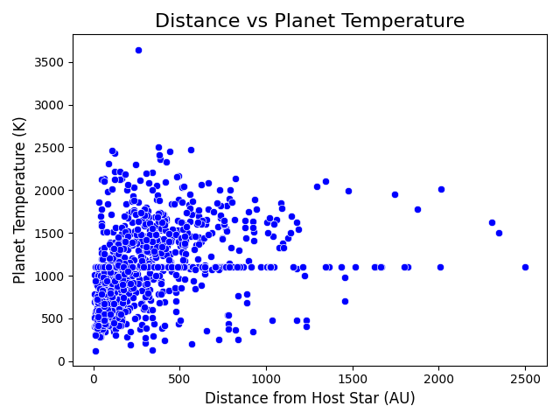
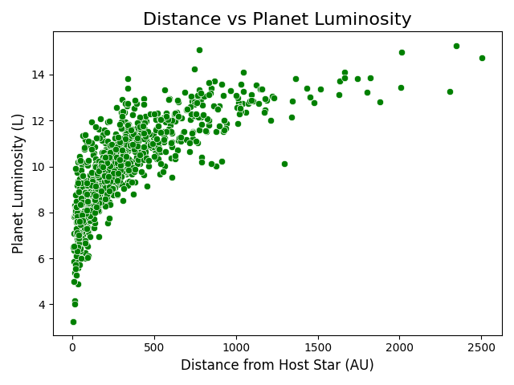

The effects of distance variation of a planet host from its exoplanets on its' temperature and luminosity?

Slide 22
What are the most and least popular discovery methods and why?
Hypothesis- True
The analysis shows the hypothesis was true . This analysis is further supported by the inverse square law of radiation.

Slide 23
Postgres SQL and Tableau

Slide 24
Conclusion

Slide 25

Questions?

Slide 26
Thank you!

